Slide 1
Just Don’t App
Bruno Casas Pescador – B00312114 Ross Shab

Slide 2
Concept
Application concept / Objective
Geolocating app that sends notifications to user once he enters areas defined as good / bad / dangerous.
User based – Users should be able to create new areas and review previously created ones.

Slide 3
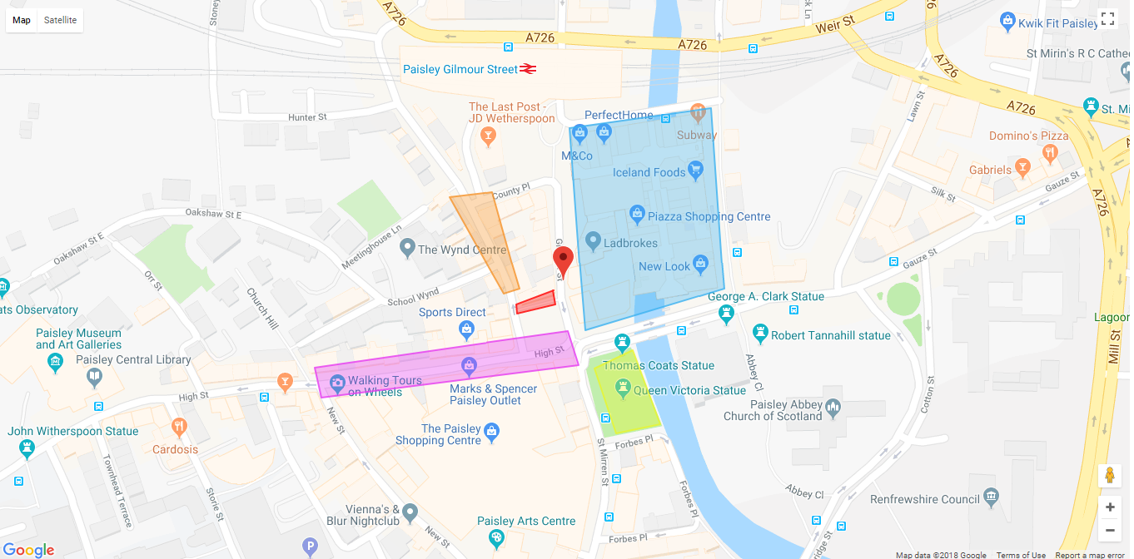
Map
Map

Slide 4
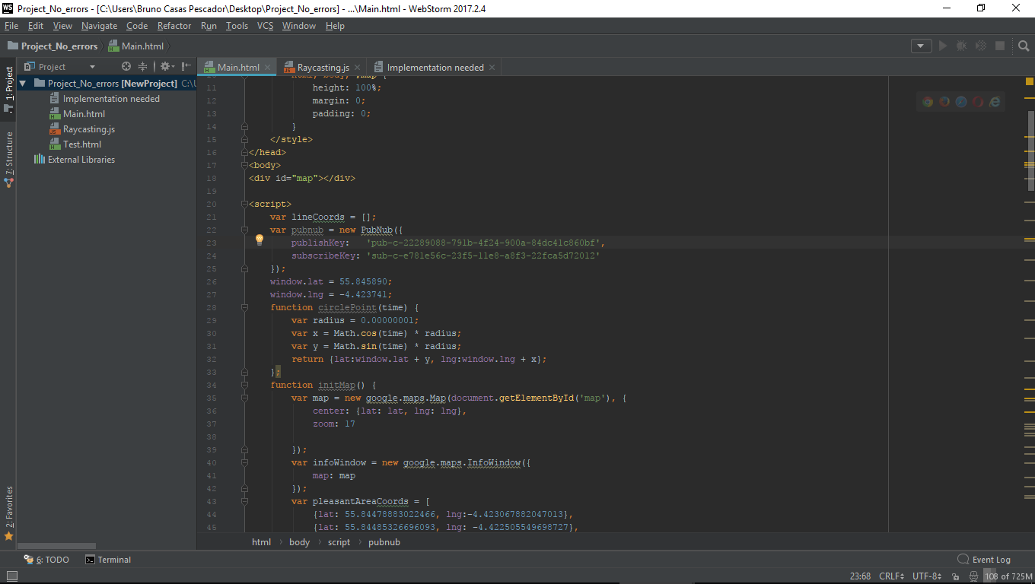
Map
Map code
Google API, Firebase, PubNub, Raycasting/Geofence

Slide 5
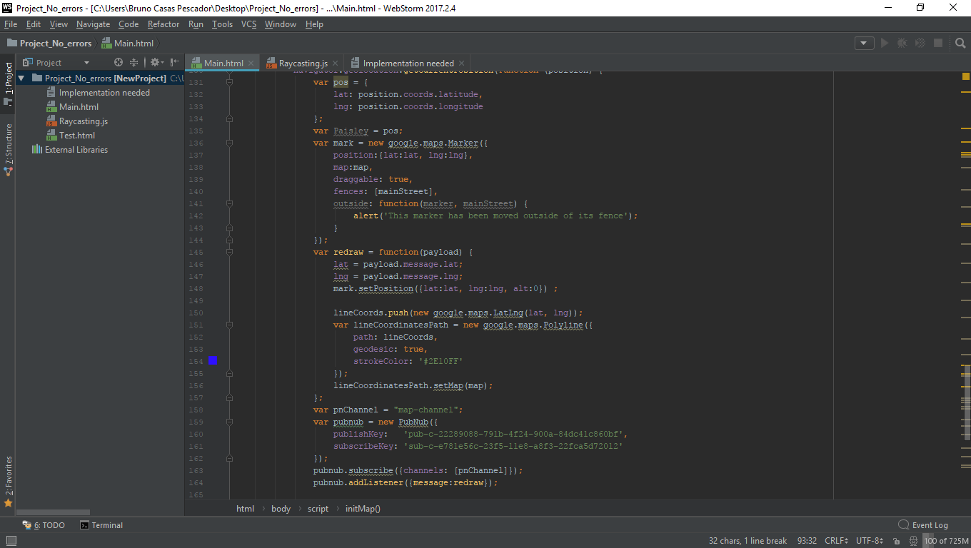
Map
Map code
Polygons(KML), Geolocation, Updating location

Slide 6
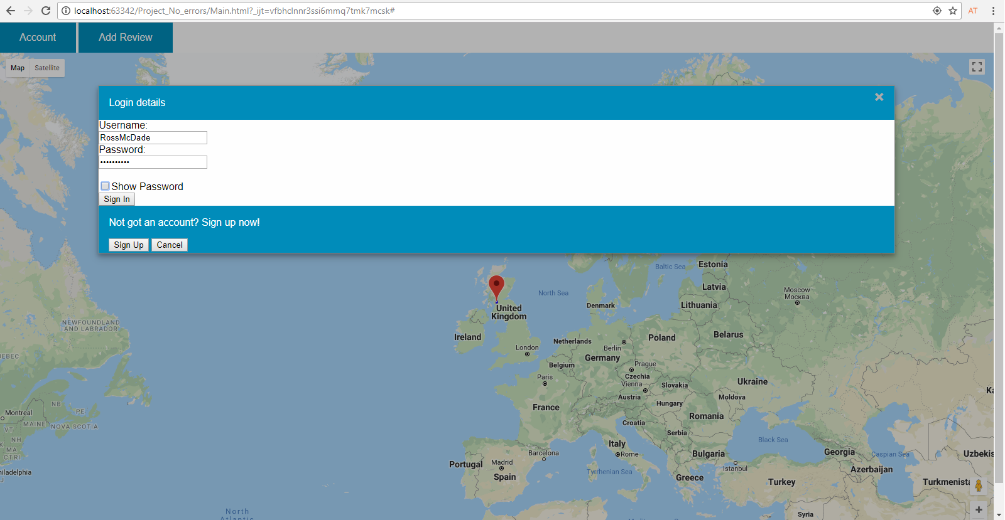

Buttons
Account button

Slide 7
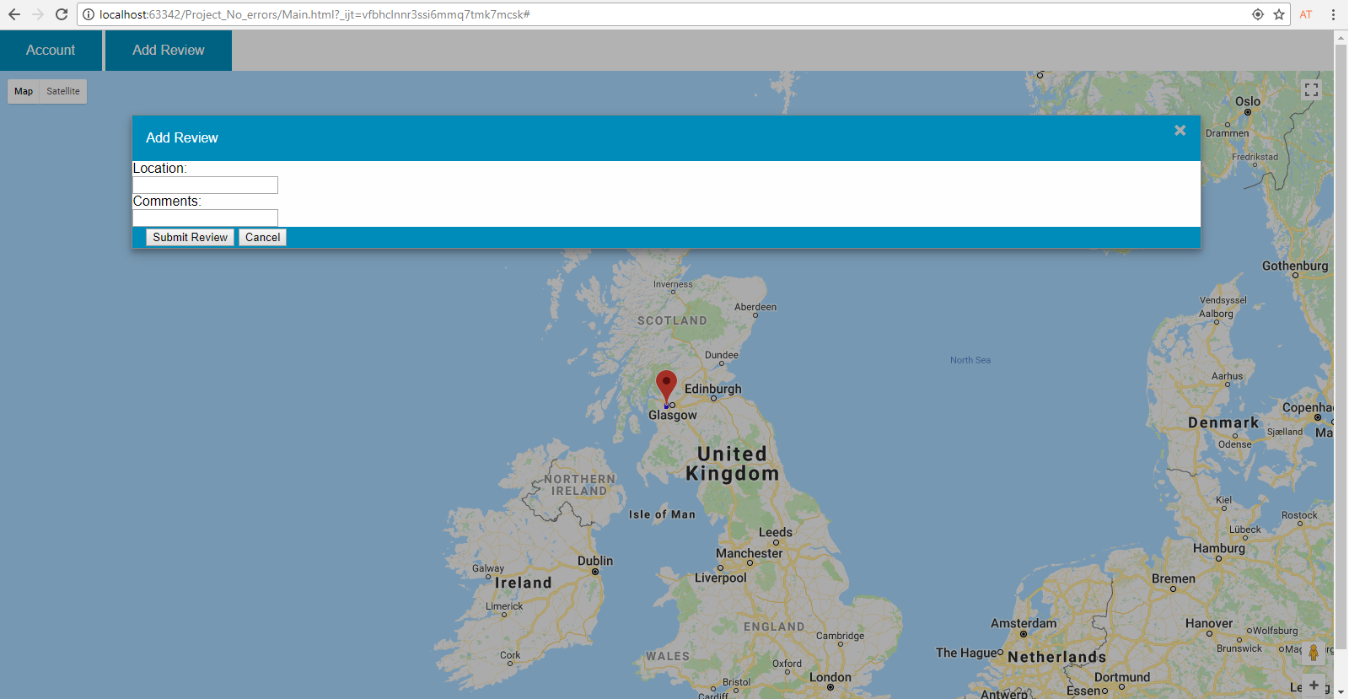
Buttons
Add Review button

Slide 8
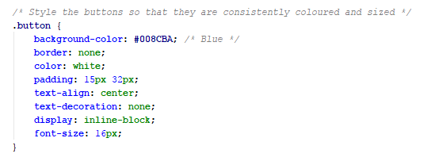

Buttons
Button code

Slide 9
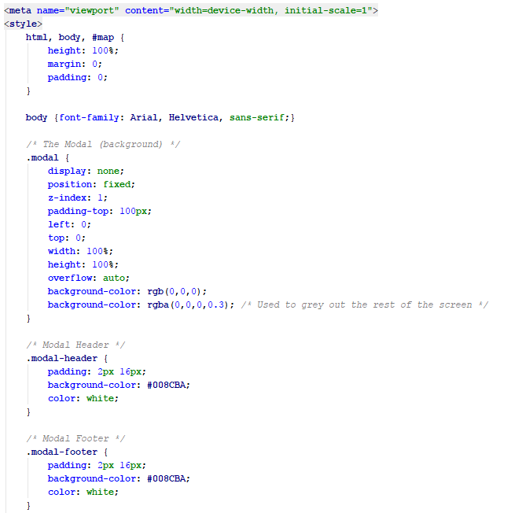
Modals
Modals CSS code

Slide 10
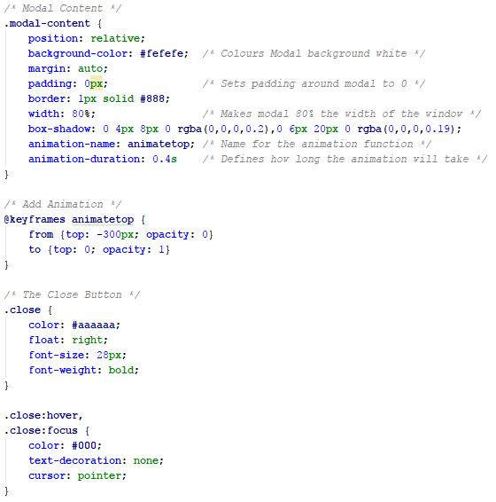
Modals
Modals CSS code

Slide 11
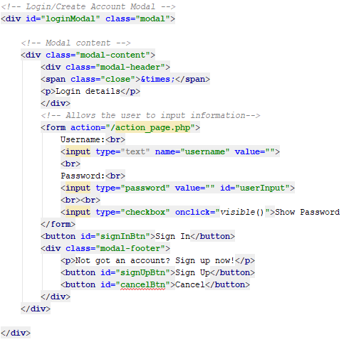
Modals
Login Modal code

Slide 12
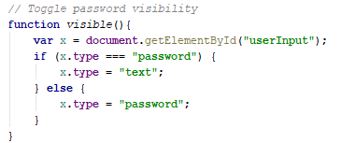
Modals
Login Modal code

Slide 13
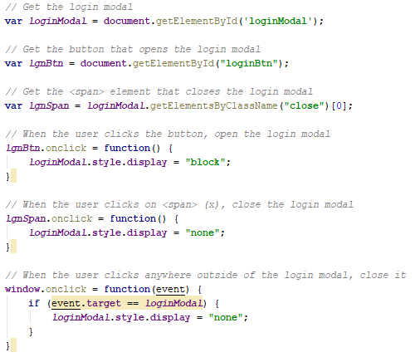
Modals
Login Modal code

Slide 14
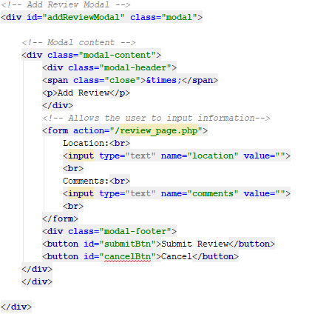
Modals
Add Review code

Slide 15
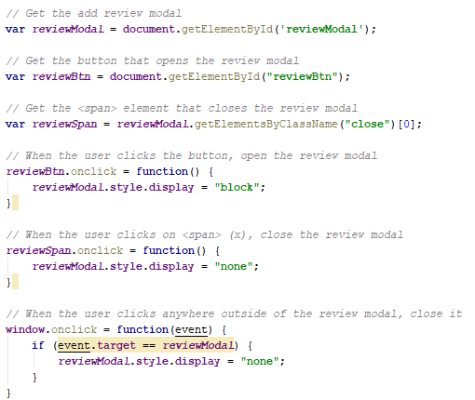
Modals
Add Review code

Slide 16
Conclusion
Conclusion
Simple concepts aren’t always simple to achieve
Coding tends to be 1 step forward 2 step backwards
Polishing and more implementation required.

